Slide 1
AIRLINE FLIGHT PERFORMANE DASHBOARD
Tableau Dashboard Project
Presented by
Aiswarya OP

Slide 2
PROBLEM STATEMENT / BUSINESS OBJECTIVES
Problem Statement
Airline operations generate large volumes of flight data, making it difficult to monitor delays, cancellations, and overall performance manually. An interactive Tableau dashboard helps visualize key metrics and supports operational decision-making.
Business Objectives
Analyze overall airline flight performance.
Monitor arrival and departure delays.
Identify top airlines by flight count.
Analyze flight cancellation trends.
Track monthly flight performance.
Develop an interactive Tableau dashboard for performance analysis.

Slide 3
DATASET OVERVIEW
Dataset Information
Industry: Aviation
Data Source: Airline Flight Performance CSV Dataset
Records: 50,000 Flights
Columns: 20
Tool Used: Tableau Public
Main Columns
Flight Date, Airline Name, Origin City, Destination City, Arrival Delay Minutes, Departure Delay Minutes, Cancelled Flag, Diverted Flag, Actual Elapsed Time, Scheduled Elapsed Time.

Slide 4
DATA UNDERSTANDING
Before creating the dashboard, the dataset was analyzed to understand its structure.
The following were identified:
Numerical columns
Categorical columns
Date fields
Flight performance attributes
Delay and cancellation information
This helped in selecting appropriate visualizations and KPIs for analysis.

Slide 5
DATA CLEANING AND PREPARATION
Data Cleaning Process
Checked missing values.
Removed duplicate records.
Verified data types.
Formatted date fields.
Validated delay values.
Prepared data for dashboard creation.
KPIs Created
Total Flights
Average Arrival Delay
Average Departure Delay
Cancelled Flights
Total Airlines

Slide 6
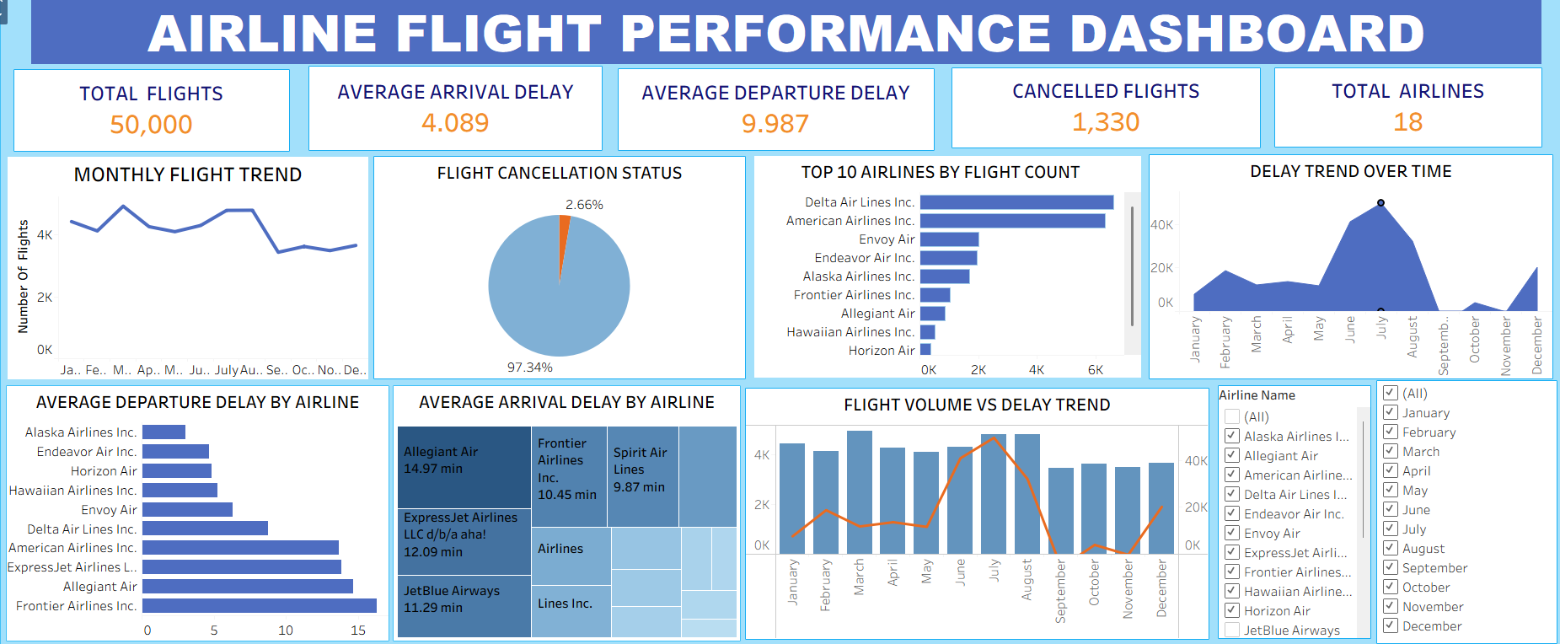
DASHBOARD SCREENSHORT

Slide 7
DASHBOARD COMPONENTS
KPI Cards
Total Flights
Average Arrival Delay
Average Departure Delay
Cancelled Flights
Total Airlines
Visualizations
Monthly Flight Trend – Line Chart
Flight Cancellation Status – Pie Chart
Top 10 Airlines by Flight Count – Horizontal Bar Chart
Delay Trend Over Time – Area Chart
Average Departure Delay by Airline – Horizontal Bar Chart
Average Arrival Delay by Airline – Treemap
Flight Volume vs Delay Trend – Dual Axis Chart
Filters
Airline Name
Month

Slide 8
INSIGHTS AND FINDINGS
Total Flights: 50,000
Total Airlines: 18
Average Departure Delay: 9.987 min
Average Arrival Delay: 4.089 min
Cancelled Flights: 1,330
Flight performance varied throughout 2025, indicating changes in airline operations.
Departure delays were higher than arrival delays.
Flight volume varied across different months.
Some airlines recorded significantly higher average delays than others.

Slide 9
CHALLENGES FACED
Challenges
Cleaning and validating the dataset.
Selecting suitable chart types.
KPI formatting.
Dashboard layout design.
Configuring interactive filters.
Maintaining a consistent dashboard design.

Slide 10
LIMITATIONS & FUTURE ENHANCEMENTS
Limitations
Static dataset.
No real-time flight updates.
Limited operational details.
Future Enhancements
Connect live airline databases.
Add airport-wise performance analysis.
Include weather impact analysis.
Add more interactive filters.

Slide 11
TOOLS & TECHNOLOGIES
Tools Used
Tableau Public
Microsoft Excel
CSV Dataset
Interactive Filters
Data Visualization Techniques

Slide 12
CONCLUSION
The Airline Flight Performance Dashboard provides an interactive overview of airline operations using Tableau.
It helps users to:
Monitor flight performance.
Analyze delays and cancellations.
Compare airline performance.
Identify monthly flight trends.
Support data-driven operational decisions.

Slide 13
THANK YOU

